Slide 1
Hajj (Pilgrimage)

Slide 2
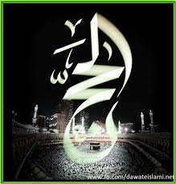
HAJJ: Literal meaning
“Hajj” is an Arabic word.
The literal meanings of word Hajj are:
to intend a journey
to set out towards a definite objective
to intend or plan for

Slide 3
Hajj in Islamic Terminology
Specific rites/rituals performed at a specific time and place in a specific way

Slide 4
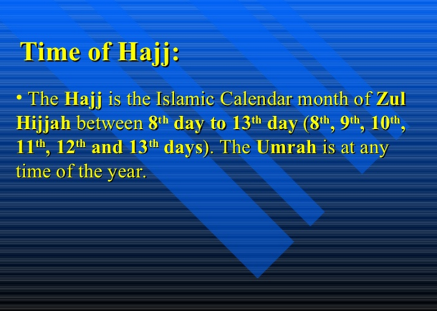

Slide 5
The conditions of incumbency
Islam
Sanity (health of body and mind)
Puberty (adult)
Ability
Mehram ( for a woman)

Slide 6
Pillers of Hajj (fraiz)
Ihram
Woqoof-e-arfat (stay at arfat)
Tawaf-e-ziarat

Slide 7
Obligatory Acts of Hajj: (Wajbat)
1) Ihraam must start at the Sharee‘ah-approved Meeqaats,
2) Standing at ‘Arafah until sunset
3) Spending the night at Al-Muzdalifah on the night of An-Nahr
4) Spending the nights of the Days of Tashreeq at Mina
5) Stoning the Jamraat: Jamrat Al-‘Aqabah must be stoned on the Day of ‘Eid and then stone the three Jamraat during the Days of Tashreeq.
6) Cutting hair or shaving head:
7) Farewell Tawaaf:

Slide 8
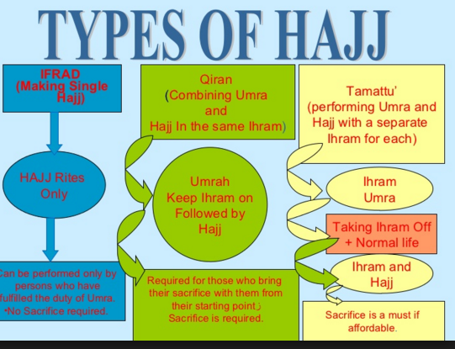

Slide 9
Importance of Hajj in the light of Quran
وَاَذِّنْ فِي النَّاسِ بِالْحَجِّ
“And proclaim among mankind the Hajj”. (Al-Hajj, 22:27)
وَلِلّٰهِ عَلَي النَّاسِ حِجُّ الْبَيْتِ مَنِ اسْـتَـطَاعَ اِلَيْهِ سَبِيْلًا
“And pilgrimage to the House is a duty of mankind towards Allah, for him who is able to make his way to it. (Al-Imran, 3:97)
وَاَتِمُّوا الْحَجَّ وَالْعُمْرَةَ لِلّٰهِ
And perform properly the Hajj and Umrah (Quran: 2/196)
وَمَن كَفَرَ فَإِنَّ اللَّهَ غَنِيٌّ عَنِ الْعَالَمِين

Slide 10
Importance in the light of Hadith
“The best jihad for you is Hajj Mabrur.” (Bukhari and Muslim)
Ibn Mas’ood said: “the Messenger of Allah (p.b.u.h) said: ‘Keep on doing Hajj and Umrah, for they eliminate poverty and sin just as the bellows eliminate impurities from iron , gold and silver.’” (Tirmidhi: 810, Nasa’i: 2631)
Abu Hurayrah (may Allah be pleased with him) said: “I heard the Prophet (p.b.u.h.) say: ‘Whoever does Hajj for the sake of Allah and does not have sexual relations (with his wife), commit sin, or disputes unjustly (during the Hajj), will come back like the day his mother gave birth to him.’” (Bukhaari: 1449, Muslim: 1350) Ibn Umar reported that the Prophet (p.b.u.h.) said: “The one who fights for the sake of Allah and the pilgrim who goes for Hajj or Umrah are all guests of Allah. He called them and they responded; they ask of Him and He will give them.” (Ibn Majah: 2893)

Slide 11
Warning for not preforming Hajj
Prophet Said:” any body who is in a position to bear the expense of passage and has the means to perform the journey, but does not perform Hajj, then it makes no difference whether he dies a Christian or a Jew.
Hazrat umar Said:’ those who do not perform Hajj despite being capable to do so, I like to impose Jazia on them.

Slide 12
The Rites of Hajj

Slide 13
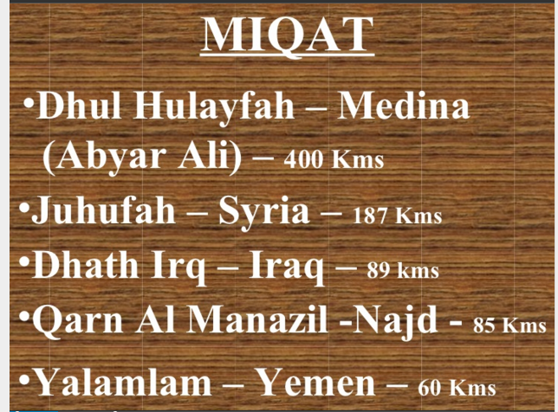

Slide 14
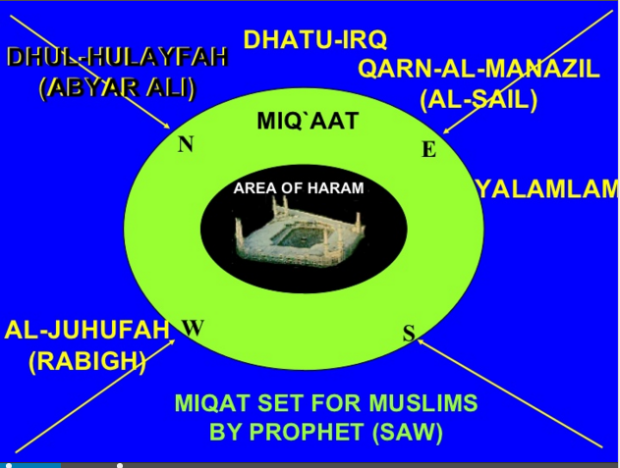

Slide 15
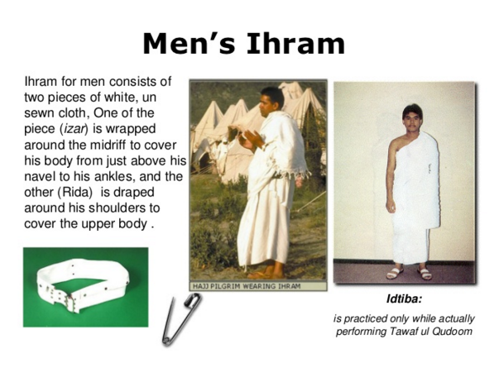

Slide 16
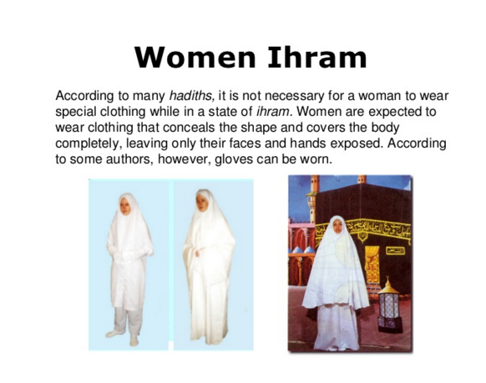

Slide 17
PHYSICAL RESTRICTIONS OF IHRAM
Cutting or shaving any hair, until the sacrifice of the animal is done.
Cutting the nails.
Men can not wear stitched clothing or head coverings ( hat, turbans).
Wearing shoes or socks above the ankle.
Covering the face.
Hunting animals etc.

Slide 18
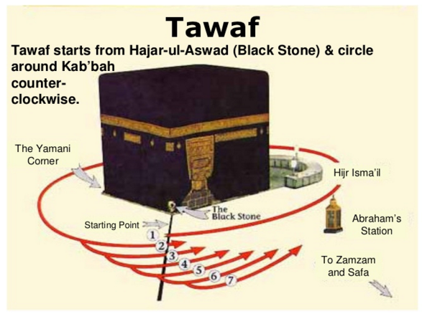

Slide 19
Kinds of Tawaf طواف
Tawaf al-Qudum طواف القدوم
meaning: “The Tawaf of Arrival” is the initial Tawaf carried out upon entering Masjid al-Haram in Makkah by those performing Hajj al-Qiran or Hajj al-Ifrad. It is identical to Tawaf al-Umrah with the exception of the intention. During Tawaf al-Qudum, Ihram is worn and Idtiba and Raml are observed.
Tawaf al-Ziyarah: طواف الزيارة
also known as Tawaf al-Ifadhah طواف الافاضة is the Tawaf that is carried out on the 10th of Dhul Hijjah after leaving the state of Ihram and changing into regular clothing, before returning to Mina to perform Rami al-Jamarat. (Marital relations are prohibited until this Tawaf is completed.)
Tawaf al-Wida طواف الوداع
meaning: “The Farewell Tawaf”), is performed by the pilgrim just before leaving Makkah after completing the Hajj. It is the final rite that is performed in Makkah prior to moving on to the next destination.
Tawaf al-Umrah العمرة‎‎ طواف
‎‎ is the Tawaf that is carried out by those performing Umrah outside of the Hajj season and those who have the intention of performing Hajj al-Tamattu. It is identical to Tawaf al-Qudum with the exception of the intention that is made. During Tawaf al-Umrah, Ihram is worn and Idtiba and Raml are observed.
Tawaf al-Nafl طواف النفل
is a voluntary Tawaf that may be performed anytime and as often as desired.

Slide 20
Rituals/ rites/ ceremonies of hajj
https://www.youtube.com/watch?v=w-EJJ-r3jl8

Slide 21
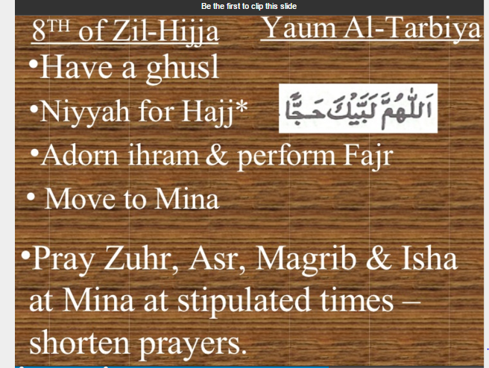

Slide 22
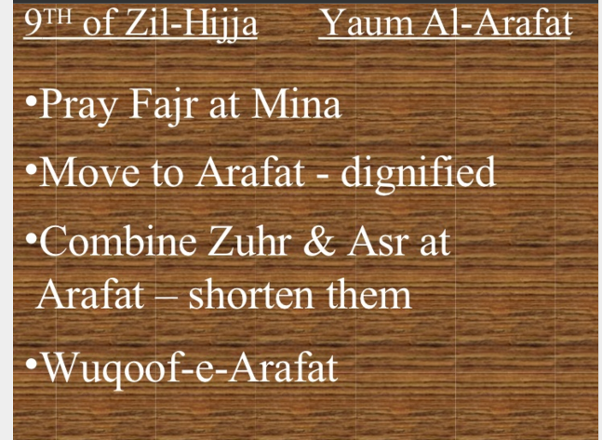

Slide 23
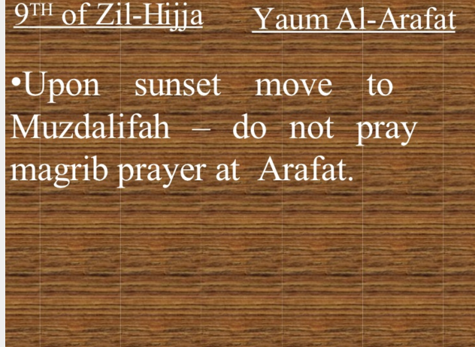

Slide 24
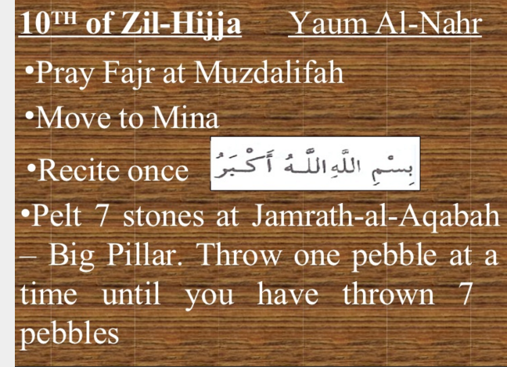

Slide 25
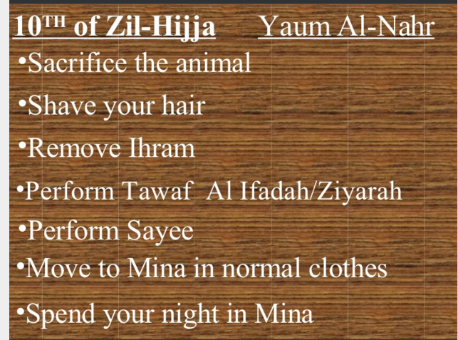

Slide 26
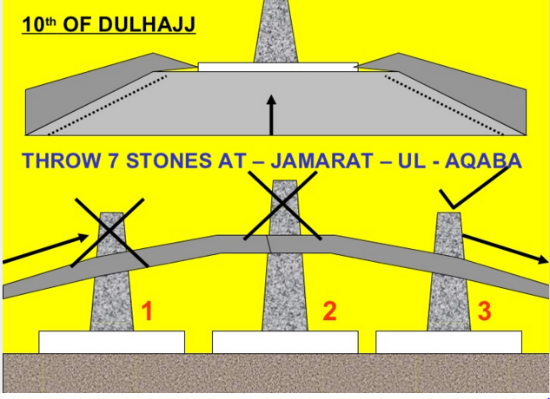

Slide 27
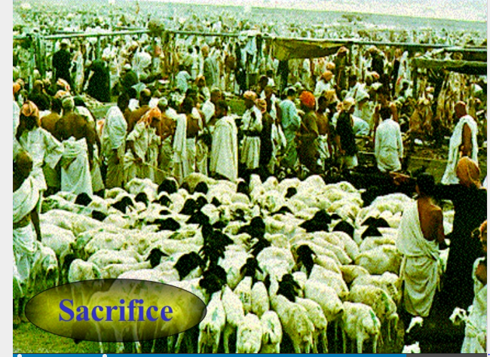

Slide 28
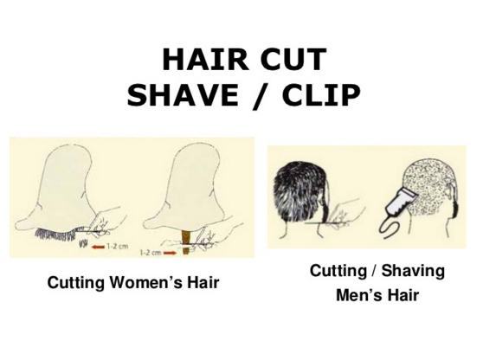

Slide 29
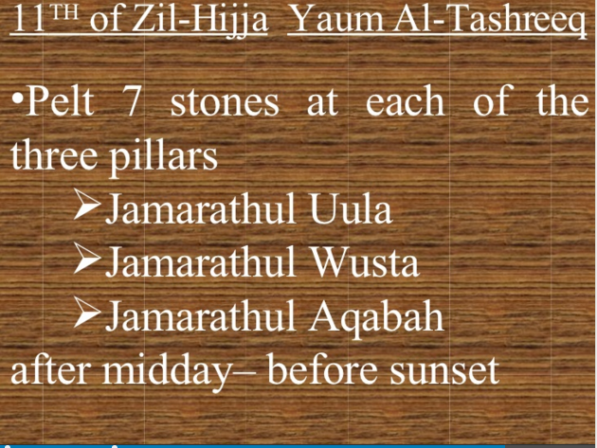

Slide 30
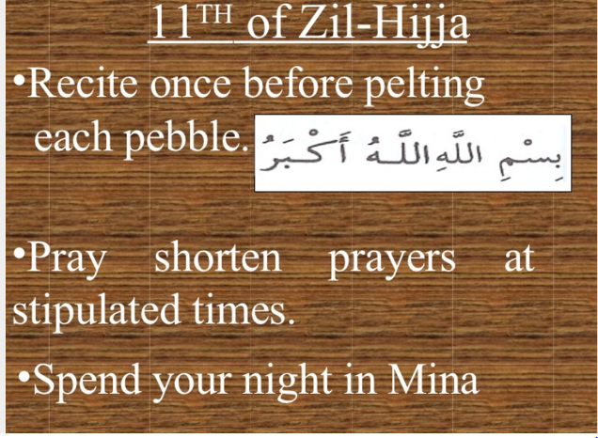

Slide 31
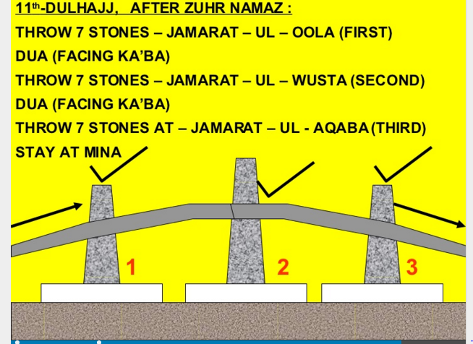

Slide 32
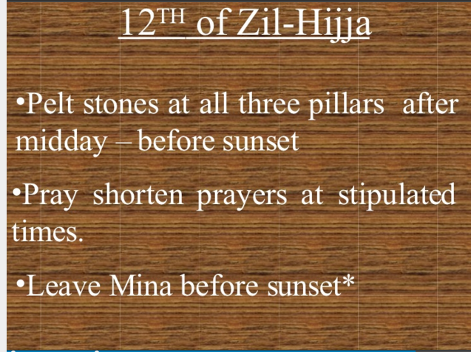

Slide 33
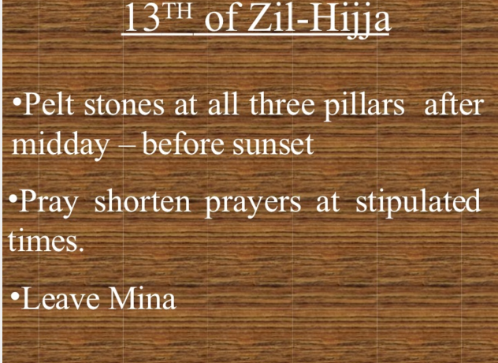

Slide 34
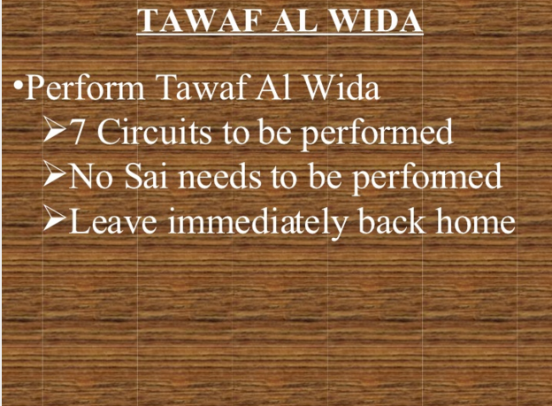

Slide 35
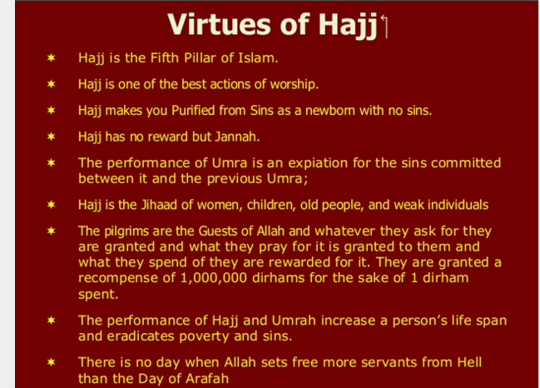

Slide 36
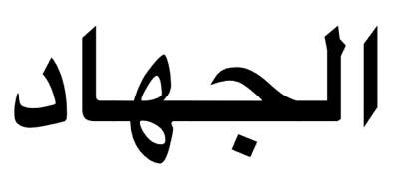
SIGNIFICANCE OF HAJJ
Religious as well as Social significance
Opportunity of self-renewal
Reminder of the Day of Judgment
Unites the Muslims(symbol of equality)
"Jihad"

Slide 37
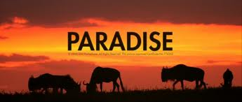
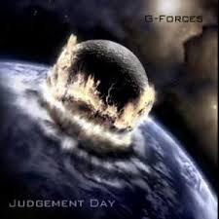
SIGNIFICANCE OF HAJJ(continues)
Reward is paradise
Peace for Haji in this
world and absolution in
the hereafter
Who dies in the way,
will not be made to on the
Judgment Day
The Divine Law

Slide 38
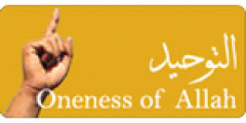
STRENGHTENING IN FAITH
Affirm commitment to Allah
The recognition of the
Oneness of the Almighty
Sense of spiritual rebirth

Slide 39
objectives/Purposes/ Benefits of Hajj
Unity Among Muslims
Equality Among Muslims
Glorious congregation(comprehensive worship)
Spiritual Elevation
A chance to become a Newborn Muslim
A lesson for total submission to God
Discipline, Self Restraint and Taqwah
An Opportunity for Repentance
Firmness against Shaytan
A Rehearsal for Meeting With the Lord
Preparation for the Ultimate Sacrifice

Slide 40
Financial Benefits
It is also allowed in Hajj to make financial transactions as per a verse in the Holy Quran.
Utilizing the great assembly of Hajj for strengthening the financial foundations of the Islamic nations is not only consistent with the spirit of Hajj but according to the Islamic traditions constitutes one of the philosophies for it, instead.
What is the harm if the Muslims, in that great gathering, were to lay the foundations of a common and associated Islamic market, and pave the way for commercial transactions amongst themselves in a manner such that neither do their profits enter the pockets of their enemies nor does their economy become dependent upon the others;
And if such is the case, not only is this not ‘craving for the world’ but rather, an act of worship and jihad (in the way of God).

